Slide 1
London House Price
Deep Dive 12:
Perry Huang
Yiqiu Song

Slide 2
Category
Introduction (Milestone 1)
Data and Model (Milestone 2, 3)
Results and Conclusion (Milestone 4, 5)

Slide 3
Introduction
Milestone 1

Slide 4
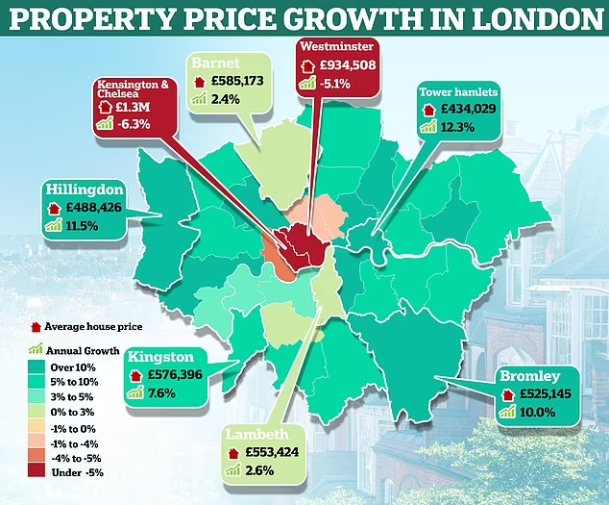
Background
London’s housing market is one of the most dynamic and expensive in the world. Prices change quickly across districts and even within the same post-code ¹.
Recurrent Neural Network (RNN) is widely used for sequential and time-dependent prediction tasks. It outperforms classical models when past patterns influence the future.
1. Sivitanides, P. S. (2018). Macroeconomic drivers of London house prices. Journal of Property Investment & Finance, 36(6), 539-551.

Slide 5
Problem Statement
We aim to examine how London housing prices change over time, including whether past prices influence future prices and how nearby areas may affect one another.

Slide 6
Data and Model
Milestone 2, 3

Slide 7
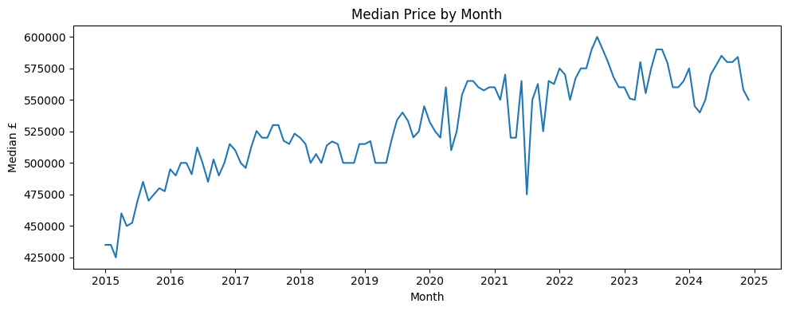
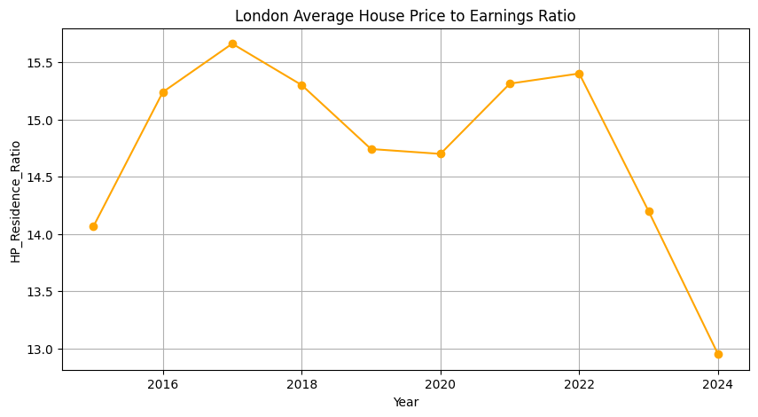
Data Sources (Overview)
1. UK Land Registry — Price Paid Dataset (PPD)
The UK Land Registry Price Paid Dataset (PPD) contains detailed records of all property transactions, including price, property type, tenure, new-build status, location, postcode, and date.
2. EPC (Energy Performance Certificate) Data
EPC data provides structural characteristics of homes at the postcode level, such as average floor area and number of rooms. It captures key physical housing attributes that help explain price differences.
3. London Datastore — Macroeconomic Indicators
London Datastore provides key macroeconomic indicators—such as population, earnings, economic inactivity, price-to-earnings ratios, and demographic pressure—that reflect affordability and broader economic conditions across London boroughs.
Figure 1. Median house price time series and house price/earning ratio
By Yiqiu Song and Perry Huang

Slide 8
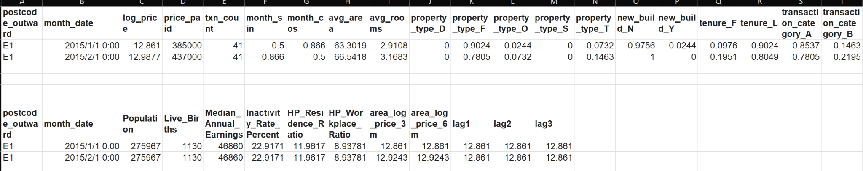
Data sample
Dataset Source | Variables Included in Final Data
Price Paid Dataset (PPD) | month_date, log_price, price_paid, txn_count, month_sin, month_cos, property_type_, new_build_, tenure_, transaction_category_, lag1, lag2, lag3, area_log_price_3m, area_log_price_6m
EPC Data | avg_area, avg_rooms
London Datastore | Population, Live_Births, Median_Annual_Earnings, Inactivity_Rate_Percent, HP_Residence_Ratio, HP_Workplace_Ratio
Includes several engineered features
log_price – reduces right-skew in price distributions
Momentum features – 3-month & 6-month rolling log price
Lag features – previous 1, 2, and 3 months’ price levels
Seasonality features – month_sin and month_cos
These engineered features play a critical role
Momentum and lag features become the top predictors in the final Long Short-Term Memory (LSTM) model ².
They help the model capture trend persistence and temporal dependence across London districts.
Figure 2. Variables for model and a sample data
2. Bouktif, S., Fiaz, A., Ouni, A., & Serhani, M. A. (2018). Optimal deep learning lstm model for electric load forecasting using feature selection and genetic algorithm: Comparison with machine learning approaches. Energies, 11(7), 1636.
By Yiqiu Song and Perry Huang

Slide 9
Technical Challenges & Why We Use LSTM
1. Multi-source data integration
We needed to merge PPD, EPC, and macroeconomic datasets, which come in different formats and update frequencies. This required substantial cleaning and careful alignment before analysis.
2. Large raw data but small training set
Although the raw dataset contained over 690,000 transactions, aggregation reduced it to only about 15,000 monthly observations. This limited training size required careful model design to avoid overfitting.
3. Time-series leakage prevention
Each postcode follows its own chronological pattern, so we had to keep the sequence strictly intact. The train–test split was performed only in time order to prevent leakage.
Why LSTM?
Housing prices exhibit strong temporal dependence with momentum and lag effects. LSTM models handle sequential patterns better than other deep learning methods for ordered time-series data.
By Yiqiu Song and Perry Huang

Slide 10
Results & Conclusion
Milestone 4, 5

Slide 11
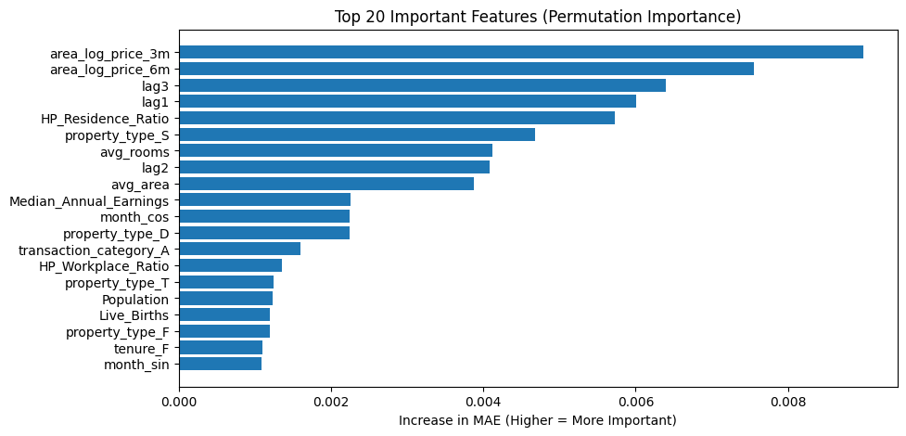
Results & Conclusions
1. Prices follow momentum.
Recent 3–6 month trends are the strongest predictors, meaning markets rarely reverse suddenly.
2. Housing markets show inertia.
Today’s price conditions strongly shape next month’s outcomes, and neighbouring areas influence each other.
3. Affordability limits long-term growth.
Areas where prices rise faster than incomes eventually slow down — crucial for buyers and policymakers.
4. Property characteristics influence baseline value.
Larger homes and more rooms matter, but they do not drive month-to-month price changes.
5. Macro & demographic factors matter less in the short term.
Population and birth trends shape long-term planning rather than monthly price movements.
Figure 3. Top 20 important features

Slide 12
Why Chose Our Model
Strong accuracy at borough level:
Mean Absolute Percentage Error (MAPE ≈ 17%) — suitable for high-level housing market forecasting.
Reasonable absolute error range:
Median Absolute Error (≈ £56,800), reflecting the typical deviation between predicted and actual prices.
Captures market dynamics effectively:
LSTM learns lagged price patterns and 3–6 month momentum, which improves prediction stability.
Consistent trend reproduction:
The model tracks overall price trends over time, showing reliable directional forecasting even during volatility.
By Yiqiu Song
Helps users make actionable decisions
Investors → evaluate short-term price momentum.
Developers → identify boroughs with rising demand.
Policymakers → track affordability pressures across time.
Buyers → understand whether an area is trending up/down.

Slide 13
Reference
Sivitanides, P. S. (2018). Macroeconomic drivers of London house prices. Journal of Property Investment & Finance, 36(6), 539-551.
Land Registry. (n.d.). Use-land-property-data service. https://use-land-property-data.service.gov.uk/
Open Data Communities. (n.d.). Energy Performance Certificates (EPC) data. https://epc.opendatacommunities.org/
Greater London Authority. (n.d.). London datasets. https://data.london.gov.uk/dataset/
Bouktif, S., Fiaz, A., Ouni, A., & Serhani, M. A. (2018). Optimal deep learning lstm model for electric load forecasting using feature selection and genetic algorithm: Comparison with machine learning approaches. Energies, 11(7), 1636.

Slide 14
Thank You

